Slide 1

The A-Team
Project Milestone Review

Slide 2

IMDb Movie Genre Classification
Synopsis - Create a Movie Genre Classification Model by implementing the data science pipeline.
IMDb (an acronym for Internet Movie Database) is an online database of information related to films, television programs, home videos, video games, and streaming content online – including cast, production crew and personal biographies, plot summaries, trivia, ratings, and fan and critics’ reviews.
We intend to use the IMDb dataset to predict the primary genre of a movie, relying only on the natural language description of the movie on IMDb. Our model would be able to predict genres from natural language descriptions. The knowledge extracted from this task can also be transferred with little effort to more impactful problems.

Slide 3

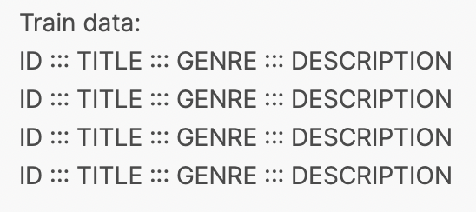
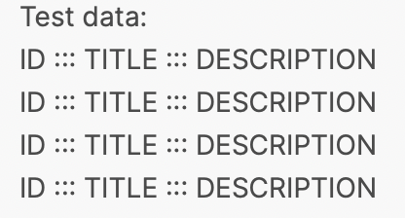
Overview
We are using the IMDb dataset from Kaggle. The train data has 54212 rows and the test dataset has 54200 rows.
Progress made so far:
Data Preprocessing
Exploratory Data Analysis
Preliminary results using 3 multiclass classification models

Slide 4
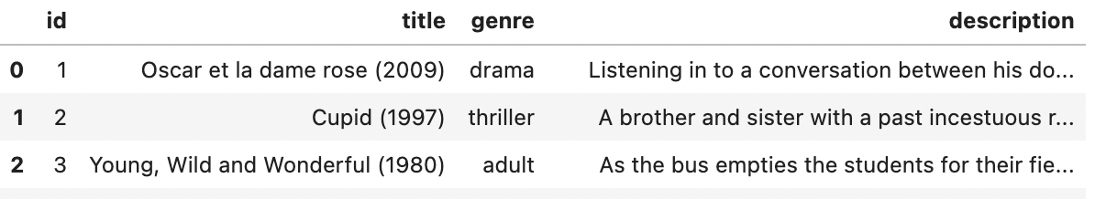
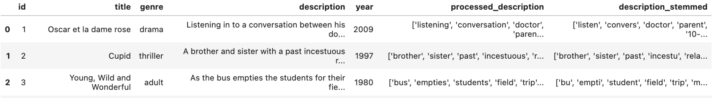
Data Preprocessing
The dataset has no missing values.
Snapshot of the dataset is as shown below:
For preprocessing,
Removed stopwords, punctuations, etc. in description.
Performed Stemming
Extracted years
Snapshot of resulting dataset:

Slide 5
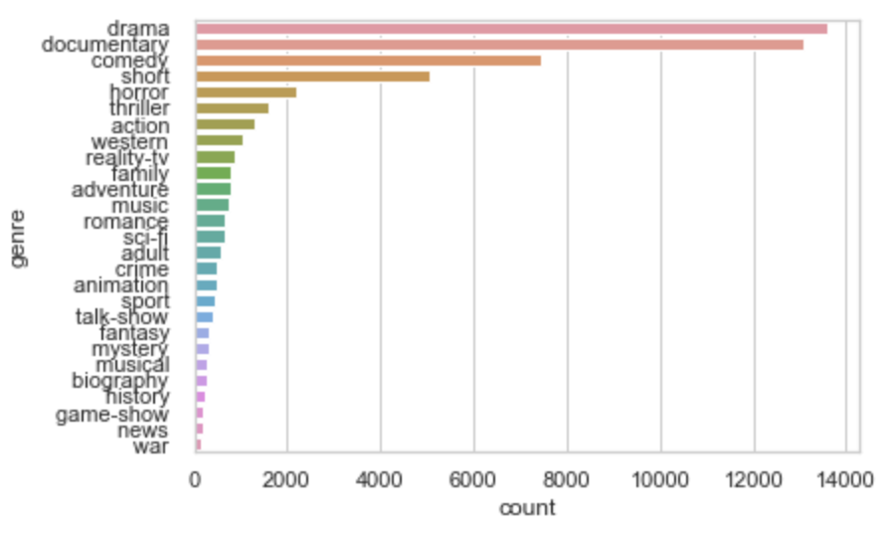
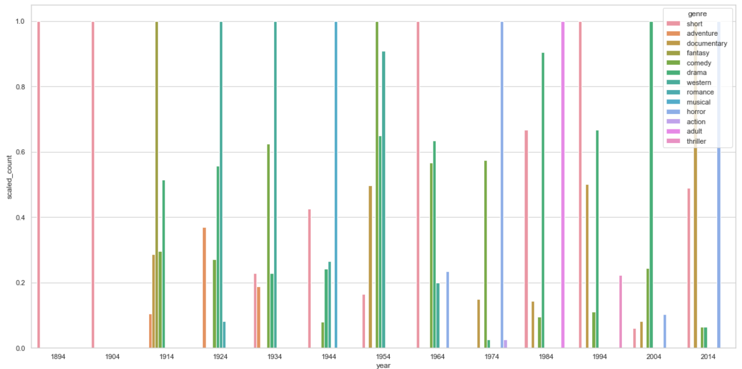
Exploratory Data Analysis
The histogram of the different genres in the dataset is as follows:
We find that the count of different genre movies made changes over the years:

Slide 6
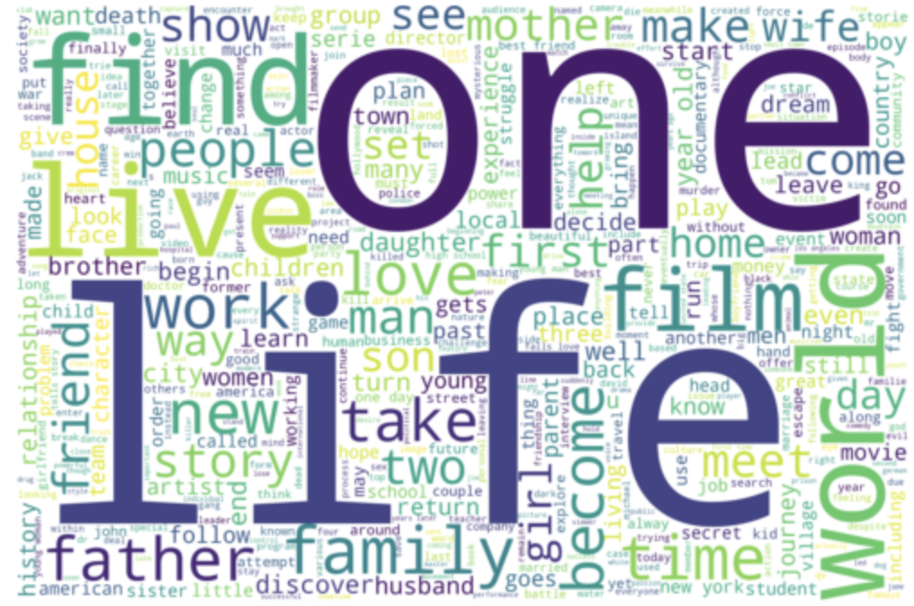
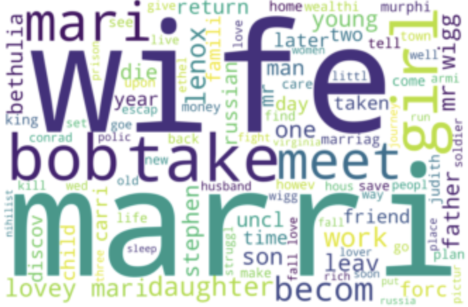
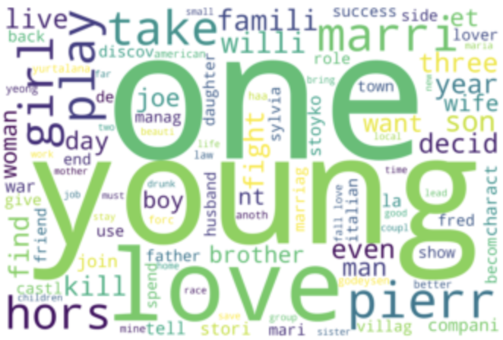
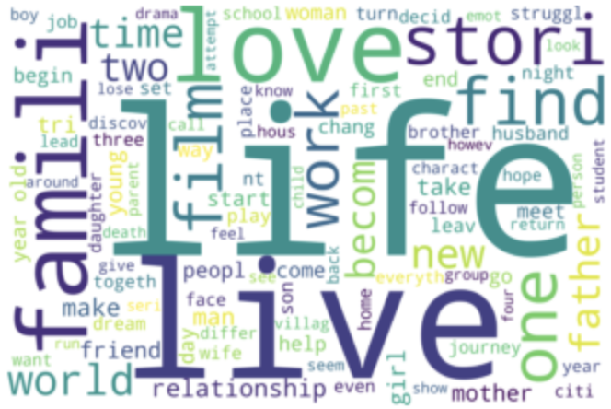
Exploratory Data Analysis
Next, we analyzed the frequent words in description column as shown in the word cloud:
We found that different genres have a different list of frequent words which also change over the years. The
word clouds for the genre drama over the years as shown below demonstrates this phenomenon:
Year 1914 Year 1954 Year 2014

Slide 7
Model Experiments
We experimented with 3 simple multiclass classification models that can be used out-of-the-box in Tensorflow/Keras. The text descriptions were tokenized to numerical vector representations of their first 32 words. The models used are:
Vanilla Neural Network: Hidden layer sizes - (128, 256, 256, 128), followed by a softmax layer
Gated Recurrent Unit (GRU): An embedding layer followed by a GRU layer followed by a softmax layer
Long Short-Term Memory (LSTM): An embedding layer followed by an LSTM layer followed by a softmax layer
We used half of the available data (48,000 examples) for training our models, including a validation set of 3,000 examples. Our evaluation was done on a small test set containing 5,000 examples. The results compare well with the baseline accuracy of 0.4, though others have done better with transformers:
Model | Iterations before Convergence | Test Classification Accuracy
Neural Network | 19 | 0.2356
GRU | 14 | 0.4822
LSTM | 10 | 0.4990

Slide 8
Future Work
Over the next three weeks, we will focus on the following tasks:
Incorporating transformer models like BERT and GPT-2.
Using engineered/extracted features other than the text of the description. Some examples of such features can be found in the table below.
Creating visualizations (like t-SNE) of our embeddings and observe the clustering behavior (like action-comedies being closer to comedies than action-thrillers, etc.).
Tabulating classification metrics like F1 Score, ROC AUC, Matthews Correlation, etc. on a per-genre (per-class) basis, to see if we’re failing on certain classes more than the others. Also measure weighted accuracy.
Finding a solution to the class imbalance in the dataset.
There are several non-English languages in the dataset. These will clutter up the vocabulary we build / embeddings we generate. We should try filtering non-English descriptions out in our first iteration.
Feature | Type
Occurence of Genre Name in Description Text | Binary (or Numerical if counting number of occurrences)
Description word count | Numerical
Description sentence count | Numerical
How many of the top-10 words pertaining to the genre are present in the description | Numerical
Year of release | Ordinal

